Slide 1
</>
SQL FINAL PROJECT
GitHub Repository &
Developer Activity Database
A relational data model and SQL analytics suite for open-source developer behavior
Chenxi Liu cl4776
Haoyi Tan ht2717
Biostatistics — Relational Databases & SQL Programming · Spring 2026

Slide 2
Background
Why model open-source activity?
GitHub generates rich, structured signals about developer behavior, project popularity, and language adoption
But raw exports are denormalized, noisy, and hard to query: a single CSV mixes user identity, repository metadata, time-series metrics, and free-text fields in one flat row.
Our goal: design a normalized MySQL schema that captures these entities cleanly, then write SQL queries that surface useful patterns.
150K+
GitHub user records
14.6K+
repository records
5
normalized tables (3NF)
02

Slide 3
Project Overview
Four analytical questions our database is designed to answer
★
Repository Popularity
↻
Project Longevity
Rank repositories by stars and forks across owners and languages.
Measure days from creation to last push to surface long-lived projects.
↑
Developer Productivity
⊕
Cross-Entity Reporting
Identify developers whose repository output exceeds the sample mean.
Combine 5 tables into a single denormalized view for downstream analysis.
03

Slide 4
Data Sources
Two public Kaggle datasets, joined on developer login
Dataset 1
Dataset 2
GitHub Repository Metadata
GitHub Users
~14.6K records · 25 columns
~150K records · 18 columns
Repository name, owner, URL, stars, forks, watchers, commit count, contributors, primary language, languages breakdown, file count, README size, community health %, creation/update/push dates.
Login, full name, company, location, follower count, following count, public repo count, account creation date, biographical fields.
Populates:
Repositories + metrics
Populates:
Developers + companies
Source: www.kaggle.com/datasets/isaacoresanya/github-repository-metadata
https://www.kaggle.com/datasets/donbarbos/github-users
04

Slide 5
Table Overview
Five tables organized into a parent–child–lookup structure
Name | Description | Role
developers | GitHub user profiles — login, name, company, location, follower & repo counts, account date. | PARENT
repositories | Repository metadata — name, owner, URL, language, description, creation / update / push dates. | CHILD
repository_metrics | Activity metrics per repo — stars, forks, watchers, issues, commits, files, community health. | CHILD (1:1)
languages | Distinct programming languages referenced by repositories. | LOOKUP
companies | Distinct employer / affiliation strings referenced by developers. | LOOKUP
05

Slide 6
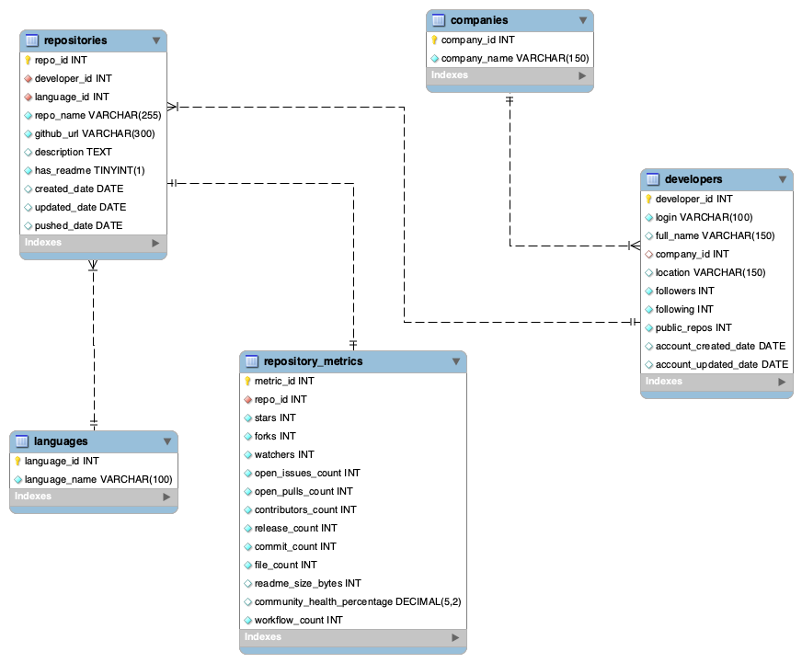
EER Diagram
Schema in Crow's-foot notation: 1 parent → 2 children, 2 lookups
RELATIONSHIPS
companies → developers
1 : N
One company employs many developers. FK developers.company_id may be NULL when affiliation is unknown.
developers → repositories
1 : N
One developer owns many repositories. FK repositories.developer_id is NOT NULL — every repo has an owner.
languages → repositories
1 : N
One language is used in many repositories. FK repositories.language_id resolved via the lookup table.
repositories → repository_metrics
1 : 1
Each repository has exactly one metrics row. FK repository_metrics.repo_id is UNIQUE — enforces the 1:1.
PK primary key FK foreign key UI unique index I non-unique index
06

Slide 7
QUERY 1
Repository Popularity Ranking
DENSE_RANK() over stars and forks — identify the most popular repos
query.sql
Result
SELECT r.repo_name,
d.login AS owner_login,
l.language_name,
m.stars, m.forks,
DENSE_RANK() OVER (
ORDER BY m.stars DESC,
m.forks DESC
) AS popularity_rank
FROM repositories r
JOIN developers d ON r.developer_id = d.developer_id
JOIN languages l ON r.language_id = l.language_id
JOIN repository_metrics m
ON r.repo_id = m.repo_id
ORDER BY popularity_rank,
r.repo_name;
repo_name | owner | stars | forks | rank
refarch-eda | ibm-cloud-arch. | 111 | 66 | 1
aws-remote-desktop-for-eda | aws-samples | 16 | 141 | 2
kinesis-data-analytics-... | aws-samples | 2 | 3 | 3
asgmt-2-programming-... | datainpoint | 2 | 0 | 4
devday-mwaa-elt-workflows | aws-samples | 2 | 0 | 4
APSJ21G7_ZOMATO_DATA_AN... | prabhatdash | 1 | 0 | 5
asgmt-1-programming-... | datainpoint | 1 | 0 | 5
python-covid-data-analysis | johnehunt | 1 | 0 | 5
Top result: IBM's refarch-eda dominates with 111 stars and 66 forks.
07

Slide 8
QUERY 2
Repository Active Span
DATEDIFF() — days between creation and last push
query.sql
Result
SELECT r.repo_name,
d.login AS owner_login,
r.created_date,
r.pushed_date,
DATEDIFF(r.pushed_date,
r.created_date)
AS active_days
FROM repositories r
JOIN developers d
ON r.developer_id = d.developer_id
WHERE r.created_date IS NOT NULL
AND r.pushed_date IS NOT NULL
ORDER BY active_days DESC;
repo_name | owner | created → pushed | days
Spreadsheet_Tutorial | krother | 2015-06 → 2021-12 | 2384
refarch-eda | ibm-cloud-arch. | 2018-10 → 2024-03 | 1977
refarch-eda-store-simul... | ibm-cloud-arch. | 2020-10 → 2024-09 | 1441
aws-remote-desktop-for-eda | aws-samples | 2019-08 → 2021-05 | 637
kinesis-data-analytics-... | aws-samples | 2021-04 → 2021-09 | 162
APSJ20G2_SALES_DATA_AN... | prabhatdash | 2020-11 → 2021-02 | 110
simpler_eda | UBC-MDS | 2021-02 → 2021-03 | 30
Long-lived OSS work concentrates among institutional owners.
08

Slide 9
QUERY 3
Popularity Classification
CASE WHEN — bucket each repository into impact tiers based on star count
query.sql
Result
SELECT r.repo_name,
d.login AS owner_login,
m.stars, m.forks,
CASE
WHEN m.stars >= 10 THEN 'High'
WHEN m.stars >= 3 THEN 'Medium'
WHEN m.stars >= 1 THEN 'Low'
ELSE 'No Stars'
END AS popularity_category
FROM repositories r
JOIN developers d
ON r.developer_id = d.developer_id
JOIN repository_metrics m
ON r.repo_id = m.repo_id
ORDER BY m.stars DESC,
m.forks DESC;
repo_name | owner | stars | category
refarch-eda | ibm-cloud-arch. | 111 | High
aws-remote-desktop-for-eda | aws-samples | 16 | High
kinesis-data-analytics-... | aws-samples | 2 | Low
devday-mwaa-elt-workflows | aws-samples | 2 | Low
asgmt-2-programming-... | datainpoint | 2 | Low
python-covid-data-analysis | johnehunt | 1 | Low
Python-FPL-Data-Analysis | MahmoudHesham099 | 1 | Low
refarch-eda-store-simul... | ibm-cloud-arch. | 0 | No Stars
Distribution: 2 High · 0 Medium · 9 Low · 44 No Stars (out of 55 repos).
09

Slide 10
QUERY 4
Developer Productivity Aggregation
COUNT, SUM, AVG with GROUP BY — total repos, stars, forks, and average commits per developer
query.sql
Result
SELECT d.login AS owner_login,
COUNT(r.repo_id) AS total_repos,
SUM(m.stars) AS total_stars,
SUM(m.forks) AS total_forks,
ROUND(AVG(m.commit_count), 2)
AS avg_commits
FROM developers d
JOIN repositories r
ON d.developer_id = r.developer_id
JOIN repository_metrics m
ON r.repo_id = m.repo_id
GROUP BY d.developer_id, d.login
ORDER BY total_stars DESC,
total_repos DESC;
owner | repos | stars | forks | avg_commits
ibm-cloud-arch. | 2 | 111 | 74 | 377.50
aws-samples | 3 | 20 | 144 | 12.67
datainpoint | 3 | 4 | 0 | 3.67
prabhatdash | 3 | 1 | 0 | 12.33
zaid-kamil | 3 | 1 | 0 | 1.67
johnehunt | 2 | 1 | 0 | 3.50
MahmoudHesham099 | 2 | 1 | 0 | 4.00
UBC-MDS | 3 | 0 | 10 | 160.00
IBM Cloud Architecture leads in stars; AWS Samples leads in forks and breadth.
10

Slide 11
QUERY 5
Above-Average Developers
Two CTEs + CROSS JOIN — find developers whose repo count exceeds the sample mean
query.sql
Result
WITH developer_repo_counts AS (
SELECT d.developer_id,
d.login,
COUNT(r.repo_id) AS repo_count
FROM developers d
LEFT JOIN repositories r
ON d.developer_id = r.developer_id
GROUP BY d.developer_id, d.login
),
average_repo_count AS (
SELECT AVG(repo_count) AS avg_repo_count
FROM developer_repo_counts
)
SELECT drc.login,
drc.repo_count,
ROUND(arc.avg_repo_count, 2) AS sample_avg
FROM developer_repo_counts drc
CROSS JOIN average_repo_count arc
WHERE drc.repo_count > arc.avg_repo_count
ORDER BY drc.repo_count DESC;
login | repos | sample_avg
a731062834 | 3 | 2.75
arda-ornek | 3 | 2.75
ArturasVan | 3 | 2.75
atasayginodabasi | 3 | 2.75
aws-samples | 3 | 2.75
datainpoint | 3 | 2.75
heathermrauch | 3 | 2.75
... | ... | ...
+ 7 more developers | 3 | 2.75
15 of 20 developers (75%) exceed the sample mean of 2.75 repositories.
11

Slide 12
QUERY 6
5-Table JOIN → Reusable View
Q6 joins all 5 tables; Q7 wraps it in CREATE VIEW with active_days and impact_level
query.sql
Result
CREATE OR REPLACE VIEW
repository_analysis_view AS
SELECT d.login AS owner_login,
c.company_name,
d.location,
r.repo_name, l.language_name,
r.created_date, r.pushed_date,
DATEDIFF(r.pushed_date,
r.created_date) AS active_days,
m.stars, m.forks, m.commit_count,
CASE
WHEN m.stars >= 10 THEN 'High Impact'
WHEN m.stars >= 3 THEN 'Medium Impact'
WHEN m.stars >= 1 THEN 'Low Impact'
ELSE 'Early Stage'
END AS impact_level
FROM developers d
LEFT JOIN companies c ON d.company_id = c.company_id
JOIN repositories r ON d.developer_id = r.developer_id
JOIN languages l ON r.language_id = l.language_id
JOIN repository_metrics m ON r.repo_id = m.repo_id;
owner | lang | stars | days | impact_level
ibm-cloud-arch. | SQL | 111 | 1977 | High Impact
aws-samples | JavaScript | 16 | 637 | High Impact
aws-samples | SQL | 2 | 162 | Low Impact
datainpoint | Python | 2 | 0 | Low Impact
aws-samples | Python | 2 | 4 | Low Impact
MahmoudHesham099 | R | 1 | 0 | Low Impact
prabhatdash | Python | 1 | 10 | Low Impact
johnehunt | Python | 1 | 0 | Low Impact
View pre-computes active_days and impact_level — no joins needed downstream.
12

Slide 13
Challenges
Three data-quality issues we encountered and how we handled them
01
Disjoint Sources
Problem: Of ~14.6K repository owners, only ~200 had matching profiles in the user dataset — the natural FK key (login) was sparse.
Fix: Curated production sample to repositories with resolvable owners; pipeline preserves the full-data path with LEFT JOIN semantics.
02
Free-text Numeric Fields
Problem: commit_count_display mixes a number with literal text ("683 commits"), so direct INT cast fails.
Fix: Regex extraction in the ETL pipeline (\d+) before loading into MySQL repository_metrics.
03
Single-Language Source
Problem: Source repository dataset is ~99% Python, leaving the languages lookup table impractically thin.
Fix: Curated 5 distinct languages for the demo schema; future work uses the JSON languages_breakdown for a many-to-many model.
13

Slide 14
Conclusions & Future Work
What we learned, and where the schema can grow
CONCLUSIONS
FUTURE WORK
Schema works. Five normalized tables (3NF) with PK/FK/index discipline support all 7 analytical queries cleanly — 0 errors and 0 warnings on full execution.
Activity is concentrated. Two institutional owners (IBM, AWS) account for the bulk of stars, forks, and commit volume; long tail of individual developers shows minimal engagement metrics.
Productivity skew. 75% of developers exceed the sample mean repo count — the distribution is tight at the top, with a small group of 2-repo owners pulling the mean down.
1
Many-to-many language model
Ingest languages_breakdown JSON into a junction table repository_languages(repo_id, language_id, bytes).
2
Time-series metrics
Convert repository_metrics to (repo_id, snapshot_date) composite PK to track growth trajectories.
3
Direct GitHub API
Scrape missing developer profiles to close the cross-source overlap gap (currently ~200/14.6K).
4
Time-zone and seasonality
Augment commit_count with timestamps for activity-pattern analysis.
14

Slide 15
</>
$ git push --tags origin final
Thank you
Chenxi Liu cl4776 Haoyi Tan ht2717
Questions?

